Slide 1
A Murder Mystery in Minnesota
A surreal Noir about a dour Midwestern town
Notes:
On January 20th, 2004, Gerald Loughlin lies dead in a pool of his own blood. Jimmy Oden responds to the murder, and like all murders, it’s a puzzle gone wrong. His house seems to be distorted in time and space, and every citizen of Cosmos, MN seems not to notice. In this small-scale adventure game, you must investigate the bizarre surroundings of the death of Gerald Loughlin. Only by unravelling this twine ball of intrigue can you piece everything back together in A Murder Mystery in Minnesota.

Slide 2
Who We Are
Aaron Curry - Creative Director - Grew up in Cosmos, MN - Popl. of 584
Davis Schmidt - Narrative - Grew up in Lennox, SD - Popl. of 2234

Slide 3
Gameplay
Investigate a murder.
Look at the crime scene for hints and clues.
Talk to people at eight locations throughout town.
Discover who exactly is Gerald Loughlin and who might have wanted him gone.
Track it all.
Personal player journal that they must write in - Default hints will be given, detail must be written.
Various red herrings throughout the town.
Map with pin system.
Find a way.
Key points of Cosmos are available during key points of the day.
Day and night cycle means that characters have their own patterns through the day.

Slide 4
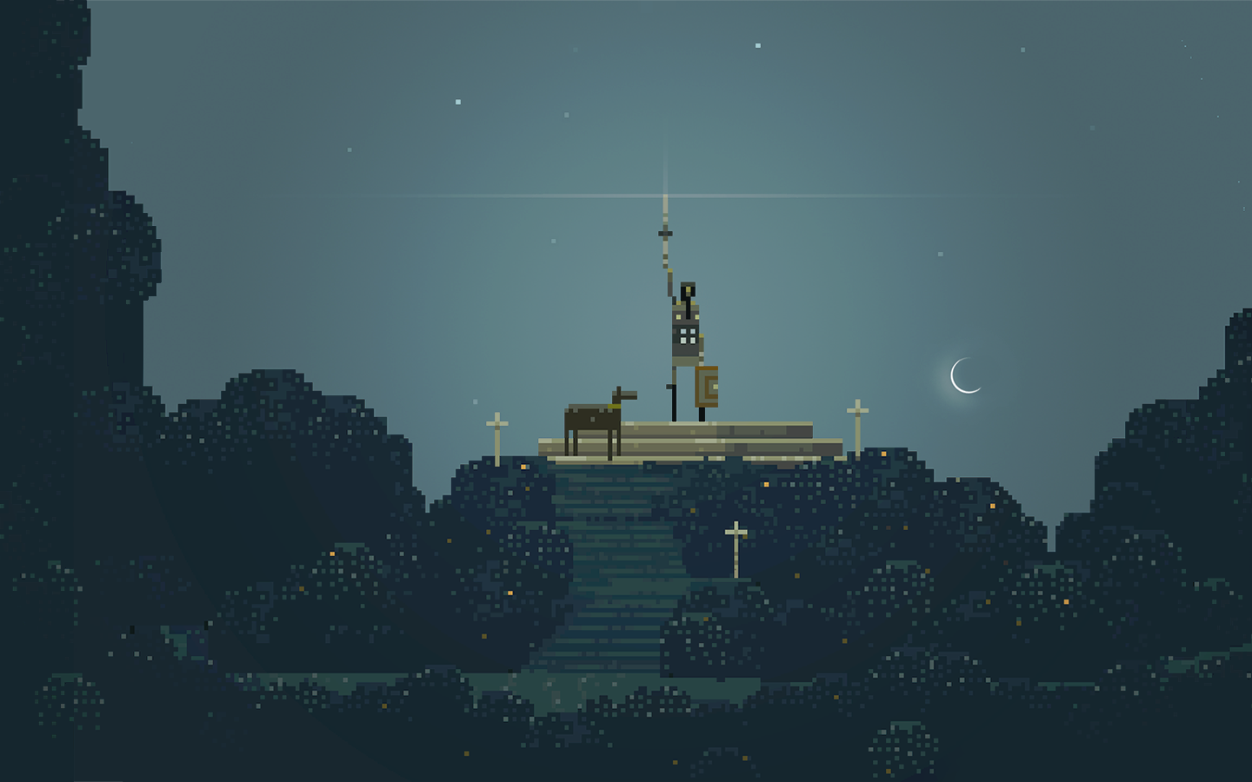
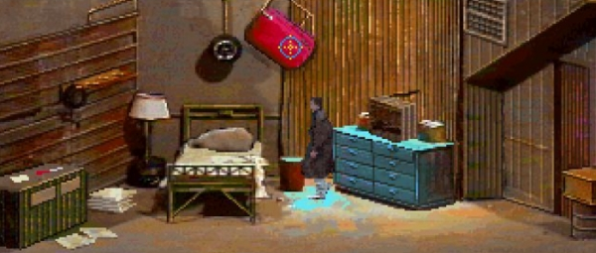
ａｅｓｔｈｅｔｉｃ
Detailed background/simple characters
Inspired by Superbrothers/Tex Murphy
Very dull and very muted.
Whatever best evokes the dreariness of the Midwest.
Quiet and understated audio
Music should be incidental (MP3 player/at scene)
Sound effects should be constant (snow/grass/tile)

Slide 5

Narrative
Modernity is the cycle of life and death in rural towns.
Despite heavy subject matter, still want levity.
Gerald was a botanist, so a lot of his experiments dealt with combining agriculture and livestock, i.e sheep with cauliflower wool.
Long list of interconnected families who are related to each other somehow
Petersens -> Petersons -> Petersans (cousins and uncles and aunts and in-laws)
“Good ending for Jimmy, bad ending for player.”

Slide 6
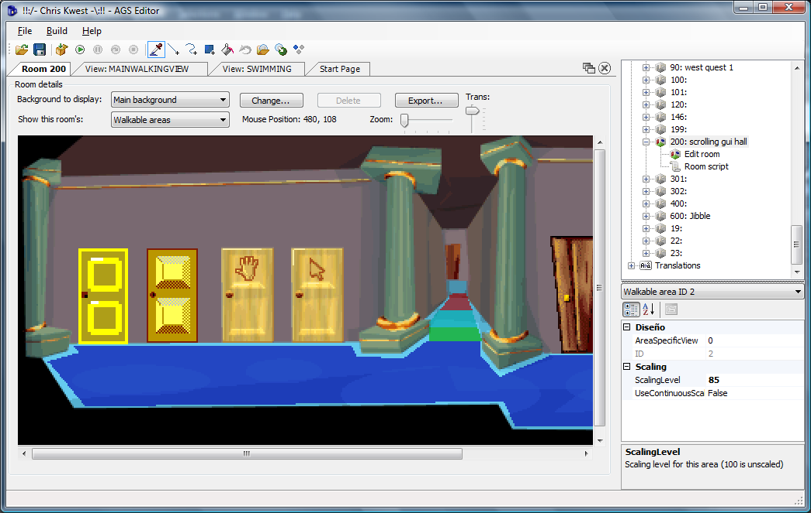
Development Team Requirements
Built in Adventure Game Studio
A lot of the basics are taken care of
Focus can be put on custom features
Two Narrative (Davis is one.)
Two Programmers (I would take this on)
Two Artists

Slide 7
Development Schedule
Summer 2017
Team goes out to Cosmos, MN which is two hours away from Madison. (Only if members can make it.) This is to take notes and pictures of the town.
Q4 2017 (First semester)
Come together and get everyone on the same page.
Get basics of gameplay down by Nanocon.
Implement early town (At least have everything be able to visit [Might not be complete]) by the end of the year.
Q1 2018 (First half of second semester)
Get half of the town finished.
Q2 2018 (Second half of second semester)
Finish.

Slide 8
?

